Slide 1
POSTION CONTROL OF QUAD ROTOR HELICOPTER
Presented By
Suruthi Raman(11012454)

Slide 2
OVERVIEW
INTRODUCTION
PARAMETERS
PID CONTROL
HOW TO TUNE PID GAIN
STABILITY
DESIGN MODEL
ADVANTAGES
APPLICATIONS

Slide 3
INTRODUCTIONS
The aim of this project is to design a 2D simulation model for a Quadcopter and design a PID controller for the Quadcopter
Quadcopter also known as Quad rotor Helicopter, Quad rotor is a multi-rotor helicopter that is lifted and propelled by four rotors.
Quadcopter are classified as rotorcraft, as opposed to fixed-wing aircraft, because their lift is generated by a set of rotors (vertically oriented propellers Unlike most helicopters,
Quadcopter uses two set of identical fixed pitched propellers: two clockwise and two anticlockwise. This use variation of RPM to control loft and torque.
Control of the Quadcopter is achieved by altering the rotation rate of one or more rotor discs.

Slide 4
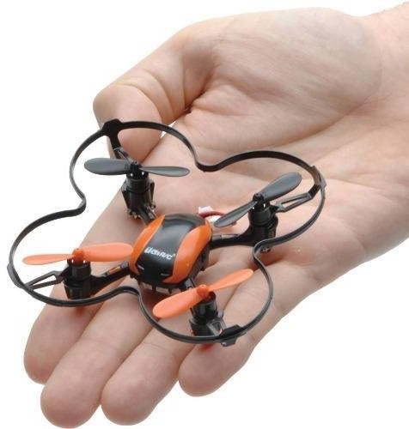
INDOOR QUADCOPTER
Indoor Quadcopter cannot use GPS for absolute positioning and magnetometers provide noisy measurements due to disturbed local magnetic field.
The best example for an Indoor Quadcopter is UDI U839, produced by UDI RC. The UDI U839 is shown below

Slide 5
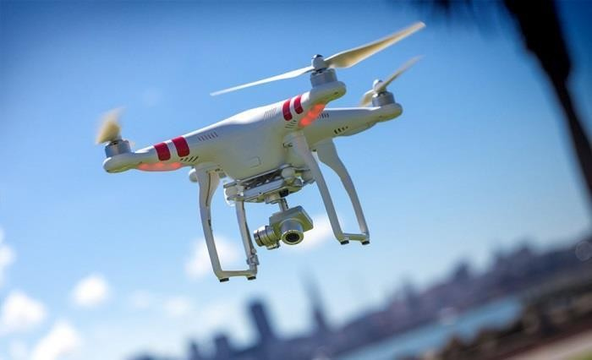
OUTDOOR QUADCOPTER
Outdoor Quadcopter are generally more durable, they take payload and can fly on longer missions than the Indoor Quadcopter. Absolute positioning is provided by GPS receiver.
The best example for outdoor Quadcopter is Phantom 2 Vision+ [3]. The Phantom 2 Vision+ is shown in the figure below

Slide 6
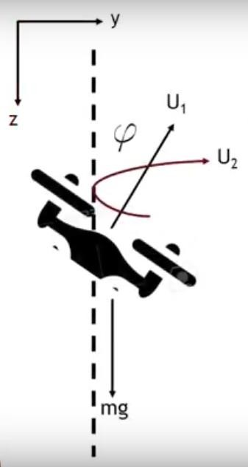
ROTOR PARAMETERS

Slide 7
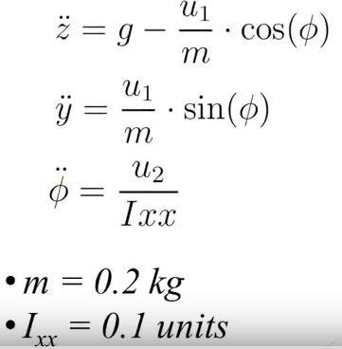
MOTION EQUATIONS

Slide 8
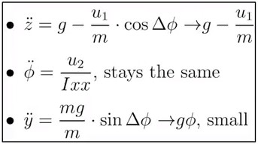
LINEARIZATION
The system is linearized around the hover point, where the properties are U2 = 0, Y = Y0, Z = Z0, U1 = mg, Angle = 0

Slide 9
PID CONTROLLER
PID (Proportional- Integral- Derivative) is a closed loop control system that tries to get the actual result closer to the desired result by adjusting the input.
Quadcopter or multicopters use PID to achieve stability.
Stability and stability robustness, usually measured in frequency domain.
Transient response, including rise time, overshoot, and settling time.
Steady state accuracy [14].

Slide 10
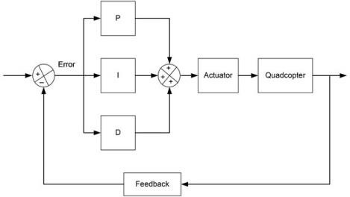
SIMULINK STRUCTURE OF PID

Slide 11
The “PID” block is the PID controller for the system. There are 3 algorithms in a PID controller; they are P, I and D respectively.
P depends on the present error,
I on the accumulation of past errors, and
D is a prediction of future errors, based on current rate of change.
These controller algorithms are translated into software code lines.

Slide 12
EFFECT OF EACH PARAMETERS
The variation of each of these parameters alters the effectiveness of the stabilization. Generally there are 3 PID loops with their own “PID” coefficients, one per axis,
so you will have to set P, I and D values for each axis (pitch 𝜃 , roll 𝜙 & yaw 𝜓 ). To a Quadcopter, these parameters can cause this behaviour.
Proportional Gain coefficient
Integral Gain coefficient
Diversity Gain coefficient

Slide 13
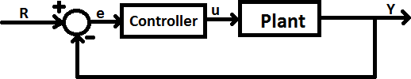
HOW TO TUNE QUADCOPTER PID GAINS
. For non-symmetric multi-copter like, Hexa-copter, Tri-copter, we might want to fine tune the pitch, roll separately, after we might want to fine tune the Pitch and Roll separately, after we have some flight experience

Slide 14
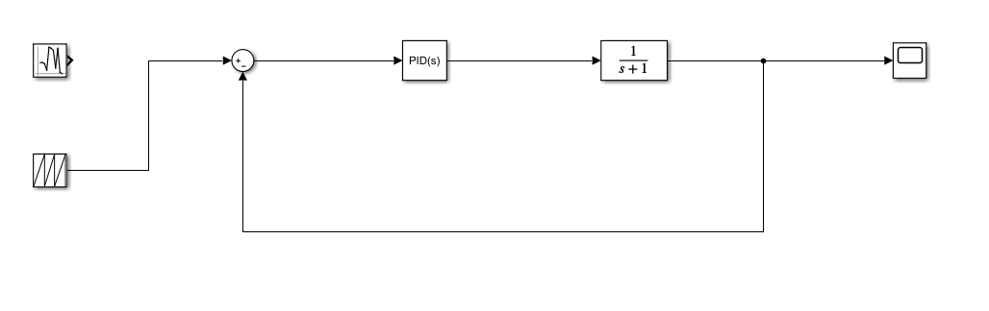
DESIGN MODEL

Slide 15
Change Model: Determine the changes to improve our model, Parameters- some parameters were initially estimated and approximated. Optimize and update parameters. Adding structure- Some parts or details of the system were not modelled. Add missing Details.

Slide 16
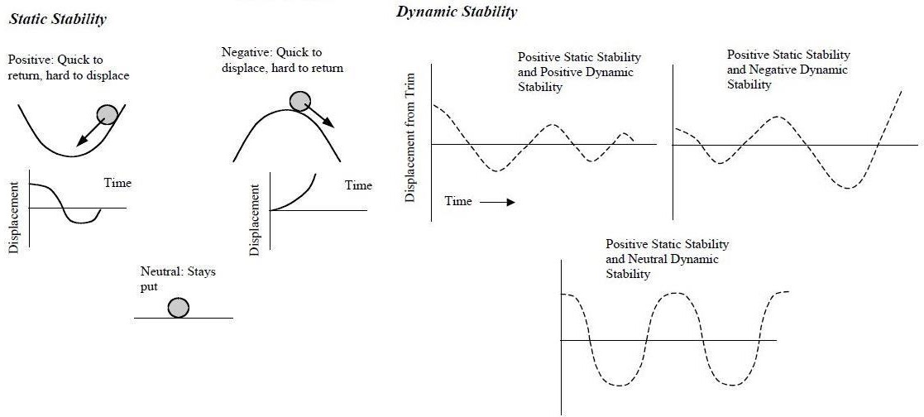
STABILITY
An object with the initial tendency to return to its equilibrium position is said to have positive static stability.
Dynamic Stability of a system or object is defined as the ability to return to a previously established steady motion, after being perturbed.

Slide 17
SATURATION
Roll Angle overshoots while initiation.
Need to cut down overshooting of signal.
Saturation helps to cut down overshooting.
Simulink provides a block for saturation explicitly

Slide 18
ADVANTAGES
Due to their ease of both construction and control, Quadcopter aircraft are frequently used as amateur model aircraft projects
This simplifies the design and maintenance of the vehicle
Secondly, the use of four rotors allows each individual rotor to have a smaller diameter than the equivalent helicopter rotor,
allowing them to possess less kinetic energy during flight.
This reduces the damage caused should the rotors hit anything

Slide 19
APPLICATIONS
Research platform
Commercial use
Military law enforcement
Investigating purpose

Slide 20
CONCLUSION
PID Controller has highly improved the stability of the
system.
Different values of PID can help us to achieve different
stability criterias.
We also employed random number generator and
observed the effects.
Certain accuracy issues present while using random
number generators.

Slide 21
REFERENCES
https://in.mathworks.com/matlabcentral/fileexchange/635
80-quadcopter-simulation-and-control-made-easy
F3-DP-2016-Gopalakrishnan-Eswarmurthi-Quadcoptor
flight mechanics model and control algorithms
https://www.youtube.com/watch?v=iS5JFuopQsA
https://www.youtube.com/watch?v=wkfEZmsQqiA

Slide 22
THANK YOU

